Slide 1
PRODML Production Reporting using Simple Product Volume
Worked Example Tutorial (v1)
PRODML Version 2.0

Slide 2
Overview
This presentation deck includes slides for the SPVR worked example. For more information, see the PRODML Technical Usage Guide, which is included in the zip file when you download PRODML from the Energistics website.

Slide 3
Outline of Capabilities
Describe the Reporting Entities:
List of entities, any arrangement of hierarchies, reference the data for the physical entity (transferred only initially)
Report Volumes per Reporting Entity:
Production, injection, dispositions, transfers to other entities, terminal lifting, deferred production & inventories
For any time period; any type of produced or service fluid
Transfer supporting data:
Well tests, well production parameters

Slide 4
Summary of Data Objects
Transfer initially then only when changes
Physical Object Data
Reporting Entity
Ref
Optional
Ref
Node
One per Entity
Optional Hierarchies
Transfer on occurrence
and/or at period end
Transfer each Period
W
W
G
G
O
O
One of these per transfer
Ref
Fluid Components
Ref
Fluid Components
Asset Production Volumes
Welltest
Transfer
Ref
Ref
All Entity volumes + fluids
Well Production Parameters
Terminal Lifting

Slide 5
Top Level Model Diagram showing central role of Reporting Entity
Hierarchy
Periodic
Volumes
Event-driven Data
Reporting
Entity

Slide 6
Section 1 – describe the assets (only done when setting up the reporting relationship)
Reporting Entity – the physical, organizational or geographic “thing” we report production data against
Simple placeholder object, which can optionally reference the “physical” data object, e.g. fully to describe a well
Hierarchies can be used to show how the Reporting Entities relate to one another in order to give context
All figures which follow relate to the Worked Example

Slide 7
Reporting Entities – Physical & Commercial Layout
Lease X
ABC Interest
Well 1
Well 2
Well 3
Well 4
Well 5
XYZ Company
commercial
Reservoir A
Contact
Interval 3-A
Contact
Interval 1-A
Contact
Interval 2-A
Reservoir B
Contact
Interval 3-B
Contact
Interval 4-B
Contact
Interval 5-B

Slide 8
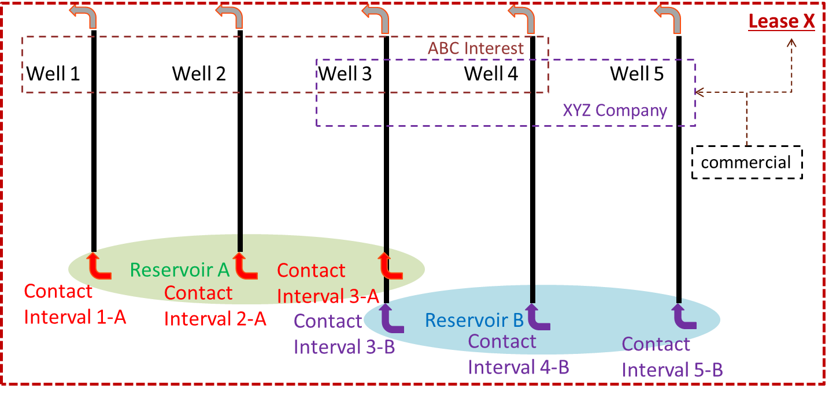
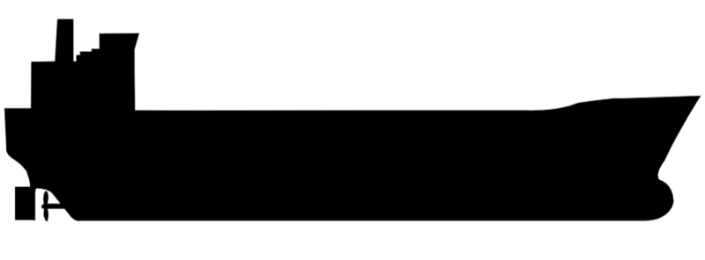
Reporting Entities – Other Related Facilities
Lease Y
Transfer
Terminal Z
Terminal Lifting
Barge 99

Slide 9
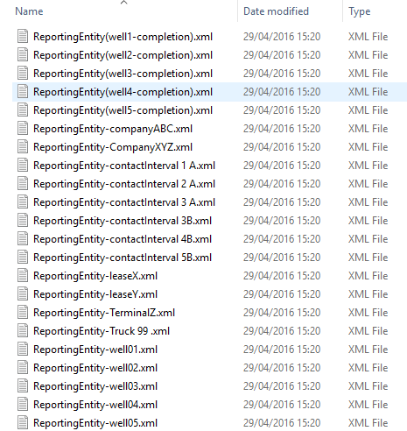
Reporting Entities are transferred one per XML file
Reporting Entities may be:
Physical, e.g. well
Geographical, e.g. State
Organizational, e.g. Company
Folder is:
ReportingEntities

Slide 10
Reporting Entities are the reporting “thing” referenced by other objects which transfer data
Reporting Entity is a small “placeholder” object
<ReportingEntity uuid="00000000-0000-0000-0000-0000000000D1" xmlns="http://www.energistics.org/energyml/data/prodMLv2" xmlns:xsi="http://www.w3.org/2001/XMLSchema-instance" xmlns:eml="http://www.energistics.org/energyml/data/commonv2" schemaVersion="2.0" xsi:schemaLocation="http://www.energistics.org/energyml/data/prodMLv2 ../../xsd_schemas/obj_ReportingEntity.xsd">
<eml:Citation>
<eml:Title>Well 1</eml:Title>
<eml:Originator>Energistics</eml:Originator>
<eml:Creation>2014-08-01T00:00:00Z</eml:Creation>
<eml:Format>Energistics:XMLSPY/.xml</eml:Format>
<eml:LastUpdate>2015-08-01T15:37:00Z</eml:LastUpdate>
</eml:Citation>
<Kind>well</Kind>
<TargetFacility uuid="58724c24-8fa8-11e5-8994-feff819cdc01"></TargetFacility>
</ReportingEntity>
This uuid is used in volumes, welltest, etc. objects to identify the reporting entity concerned

Slide 11
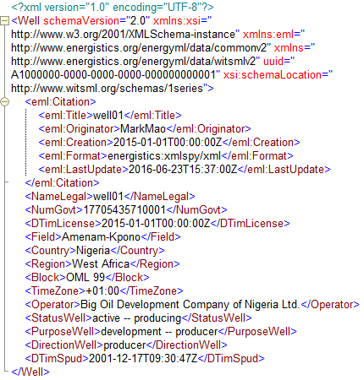
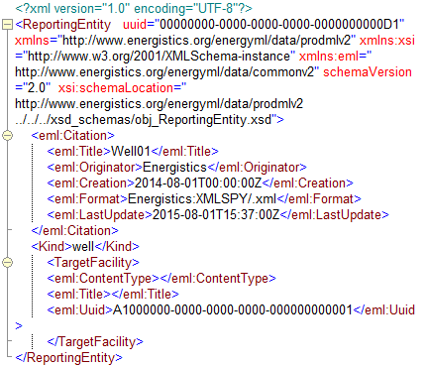
Optionally, Reporting Entities can reference a data object containing full physical data
Reporting Entity optionally has a reference to the data object describing the underlying physical asset.
Example using WITSML obj_well.
UUID Ref
Folders: Wells & wellboreCompletions

Slide 12
Reporting Entity Kinds
Reporting Entities may be:
Physical Asset, e.g. well
Geographical, e.g. State
Organizational, e.g. Company
This is not enforced in schema
Table also shows other Energistics types which can be referenced for physical data

Slide 13

Hierarchies can be defined for Reporting Entities: as many as required for different purposes – no limit on kind or name
Worked Example Reporting Hierarchies
Folder: ReportingHierarchies
Order for commercial relationships, e.g. for defining access to data:
Company (commercial entity)-Well
Normal order for volume reporting:
Lease (field)-Well-Contact Interval (layer)
Order for reservoir offtake reporting:
Lease (field)-Reservoir-Contact Interval (layer)
……

Slide 14
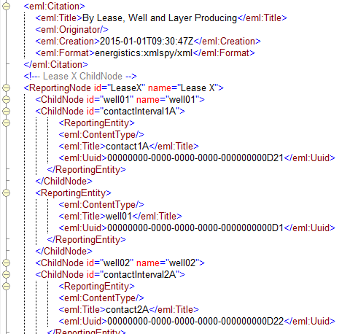
Hierarchies reference the Reporting Entities: each starts with own root node
Worked Example Reporting Hierarchies
Root node
Node with parent
This is the reference to the Reporting Entity (well 1)
……

Slide 15
Section 2 – Reporting the Quantities
Asset Production Volumes transfers all quantity data kinds for all Reporting Entities in one period
The data for each Reporting Entity is in a Reporting Entity Volumes element, which refers to the Reporting Entity described previously
All kinds of quantities may be transferred (production, inventory, sales, etc.)
The fluid components, (oil, gas, C1, C2 etc.) are transferred once per Asset Production Volumes

Slide 16
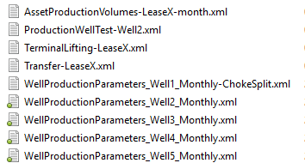
Periodic Transfer Data Objects
ALL the Volumes for all the Reporting Entities are transferred together per period in one object. This is a one month example for the asset in the worked example
The remaining data objects are intended to be transferred in event-driven manner:
Welltest
Requirement to transfer well production parameters
Transfer of production fluid between assets
Terminal lifting of production fluid by tanker
They could however all be transferred at period end together with the period volume data.

Slide 17
Content of Asset Production Volumes example
Volume Kinds included
Reporting Entities Quantities included
Worked Example Quantities included

Slide 18
Volumes Reported in Worked Example

Slide 19
Reconciliation of Quantities
Production
60,000
Opening Inventory
10,000
Transfer Inwards
50,000
Closing Inventory
20,000
Terminal Lifting
100,000
Oil
+
+
=
+
Terminal Lifting
100,000
Transfer Inwards
50,000
Sale
50,000
Oil
-
=
Production
26 million
Sale
25 million
Flare
1 million
Gas
=
+

Slide 20
Worked Example Timeline

Slide 21
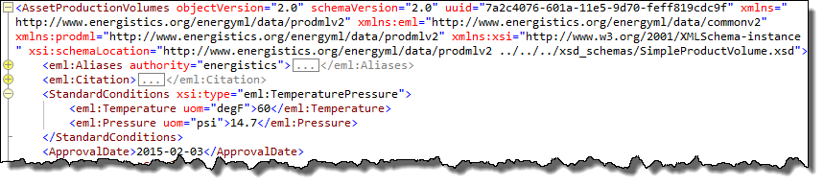
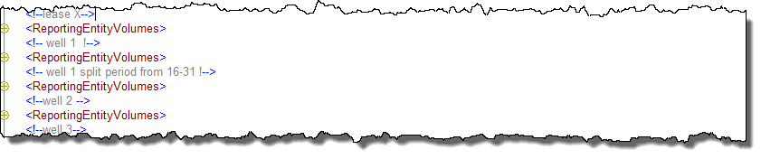
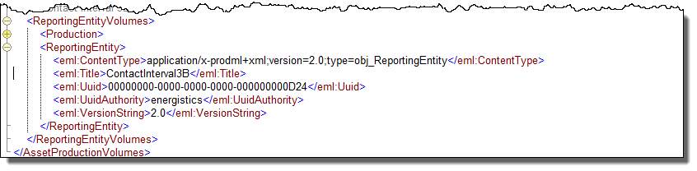
Asset Production Volumes has repeating Reporting Entity Volumes per Reporting Entity
Standard Conditions applying to all volumes in this transfer
Repeating Reporting Entity Volumes over all entities
Each Reporting Entity Volumes has a reference to the Reporting Entity for which it contains data

Slide 22
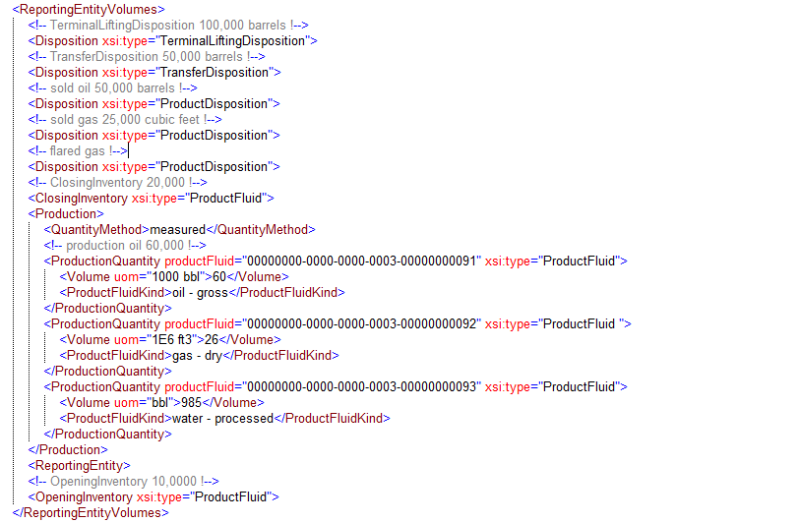
All the kinds of Quantity are contained within each Reporting Entity Volumes
Shown:
Disposition – Terminal Lifting
Disposition – Transfer
Disposition – Product Sale
Inventory – Opening
Inventory – Closing
Production
Not Shown but available:
Injection
Deferred Production

Slide 23
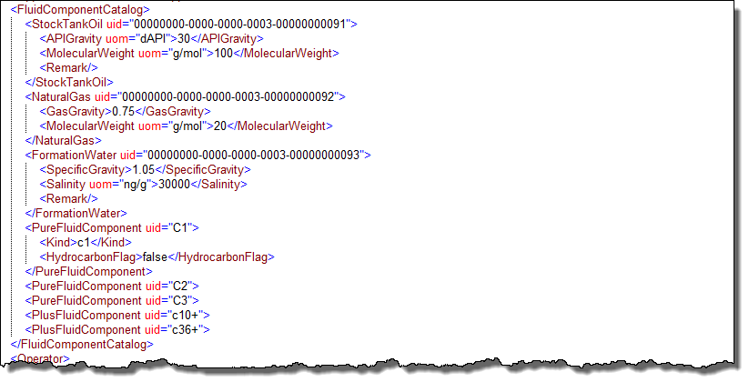
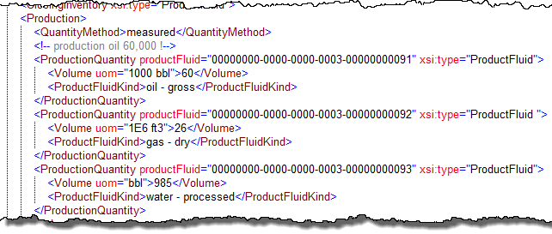
Fluid Components Transferred Once per Asset Production Volumes (periodic) object and then referenced
One Fluid Component Catalog for whole transfer
It lists and characterizes all components needed.
Could be e.g. one each of oil, gas, water,
Or, could have multiple oils with different qualities
Or, compositional with pure, pseudo, plus fractions
Each Quantity then references its component in the Catalog

Slide 24
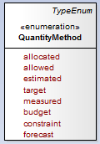
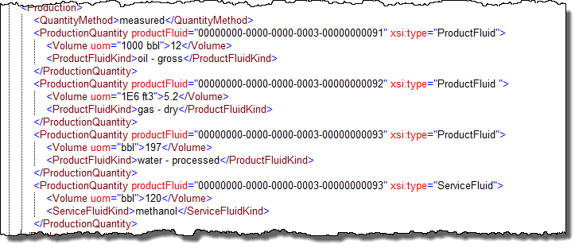
Quantity Methods and Product Fluid Kind can be included in the volumes
Each Quantity has a QuantityMethod – showing how it was determined
Product Fluid references the Fluid Component which gives the physical properties of the component.
The Product Fluid Kind is simply an enum to provide information about the product which the Production Quantity represent.

Slide 25
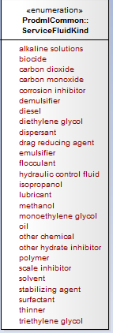
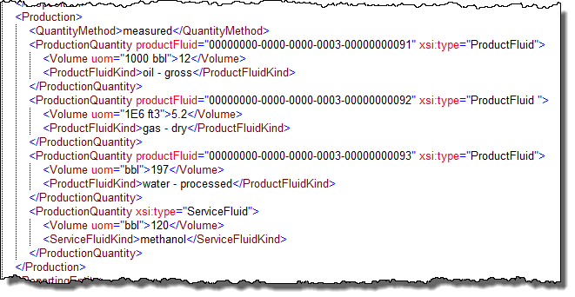
Service Fluids can be included in the volumes
Service fluids may be reported for injection (for amount used), for inventory purposes, or (as shown here) to show the contamination of produced fluids caused by residual Service Fluid quantities

Slide 26
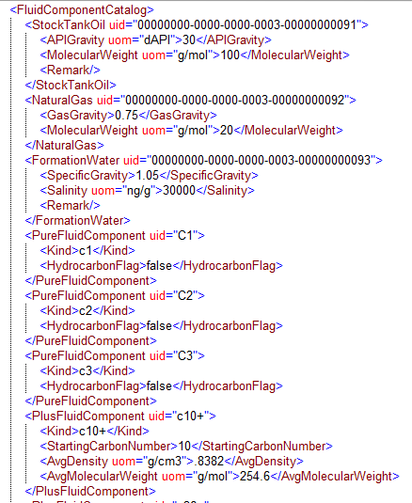
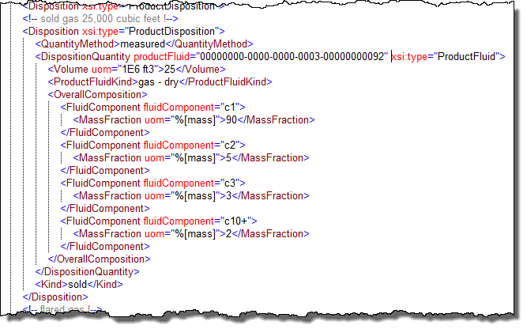
Fluids can be reported Compositionally
Note: it is not mandatory to include the ref to the Fluid Component nor to Product Fluid Kind – obviously at least one is needed.
Pure Fluid Component Kind is an enum.
For Uid, here same string as the Kind was used
Plus Fluid Component likely to have extra characterization data
The Overall Composition element provides composition in addition to the Quantity data

Slide 27
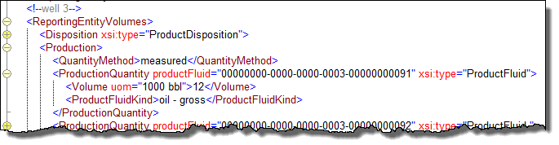
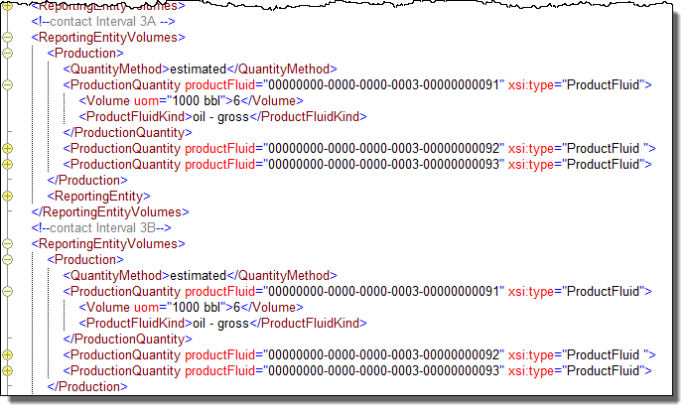
Allocation to Individual Layers
Any degree of “granularity” in the reporting can be achieved by including additional Reporting Entities.
Example, Well 3 is completed in two layers giving two Contact Intervals which are included in one of the hierarchies. Volumes can now be allocated to the two layers

Slide 28
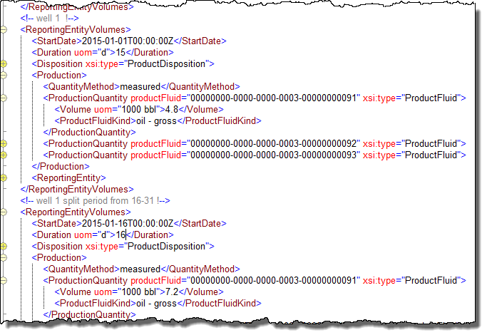
Splitting Quantities Allocated Across a Period (e.g.) because of a Choke Change
Within a period being reported, e.g. one month, it is possible to sub-divide the period so that volumes can be reported per sub-period.
This may be useful, e.g. if a well is shut in for some of the period, or if a choke change is made resulting in different flow rates, as shown here for Well 1.
See also Well Production Parameters example for the choke setting details.
The sub-period is defined by optional Start Date and Duration elements within the Reporting Entity Volumes element

Slide 29
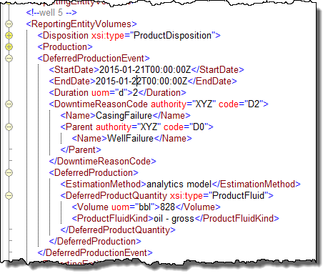
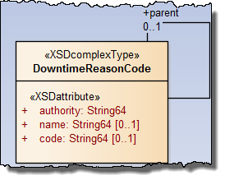
Deferred Production
Deferred Production is reported by Deferred Production Events
Downtime Reason can be reported using a hierarchy of Codes. These are company specific and not defined in the standard.
Deferred Quantity is reported as for other quantities.
There is an optional Estimation Method enum to state which method was used to estimate the deferral

Slide 30
Section 3 – Reporting the non-periodic events
Production Welltest reports a single well test
Well Production Parameters reports a range of production parameters for a single well
Transfer reports the transfer of fluid to or from outside the Reporting Entity itself
Terminal Lifting reports the loading of fluid onto a tanker for transportation to a remote terminal
The fluid components, (oil, gas, C1, C2 etc.) are transferred per instance of the above, using the same Fluid Component Catalog as used for Asset Production Volumes

Slide 31
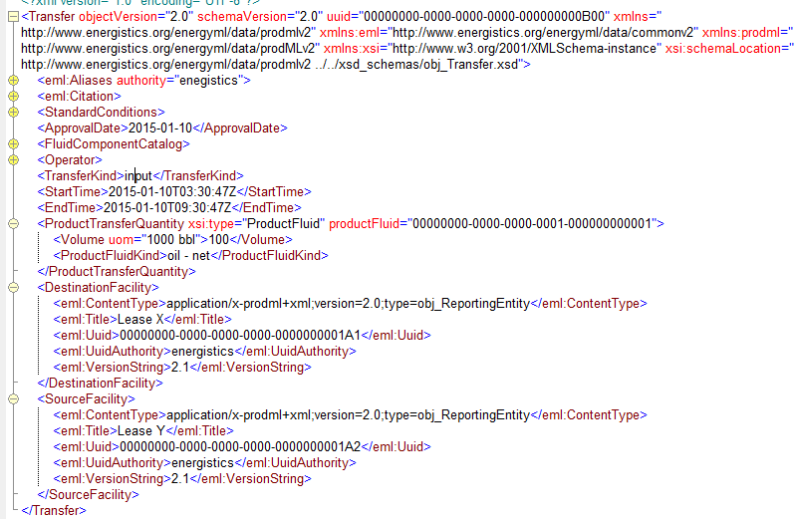
Transfer – movement of production fluid from one Reporting Entity to another via pipeline
Uses same system of Fluid Component Catalog as the Asset Production Volumes
Has Source Facility and Destination Facility. No Tanker involved – pipeline transfer.

Slide 32
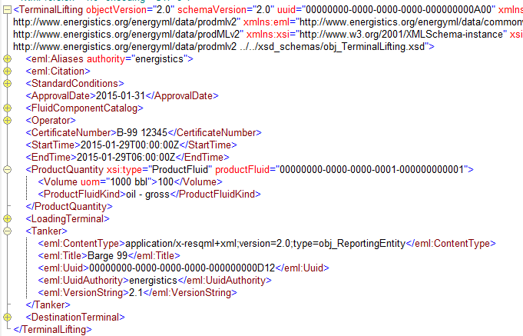
Terminal Lifting – export of production fluid from one Reporting Entity to another via Tanker
Uses same system of Fluid Component Catalog as the Asset Production Volumes
Has Loading Terminal and Destination Terminal, with Tanker involved as the means of transport.

Slide 33
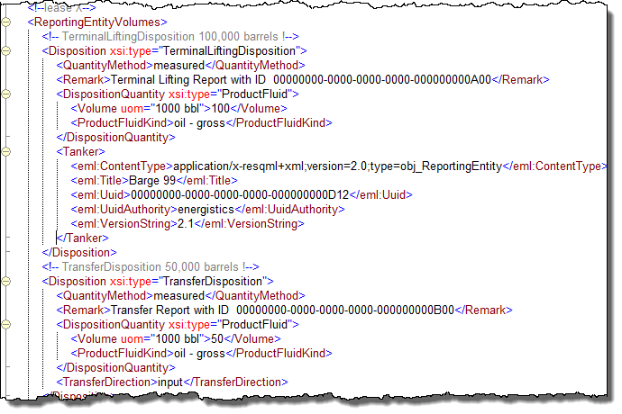
Transfer and Terminal Lifting can included in Asset Production Volumes period report “by value”
If preferred, Transfer and Terminal Lifting can be included in Asset Production Volumes as specific types of Disposition
The attributes of the stand- alone data objects can be included in the Disposition – shown, “Tanker” and “Transfer Direction”
Remark has been used to refer to the “event driven” data transfer made at the time using the stand-alone data object

Slide 34
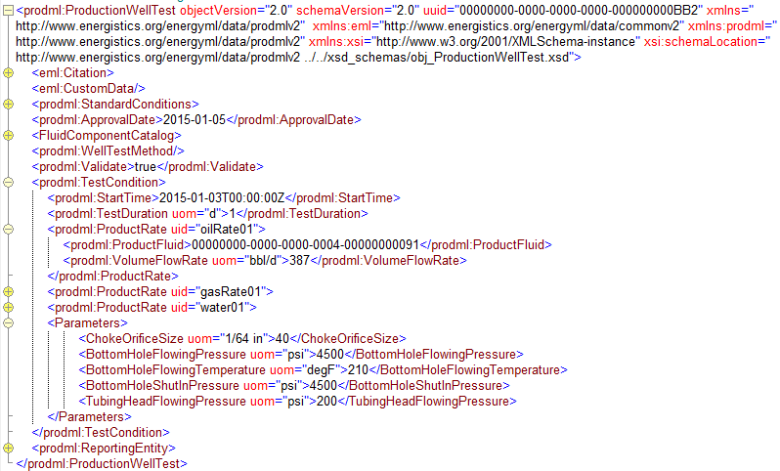
Production Welltest – expected transferred upon event
Fluid Component Catalog and ref same as other objects
Method and validation
Reports flow rates rather than Quantities
A Range of operating parameters can be included
Reporting Entity ref
(expected to be a well but not enforced)

Slide 35
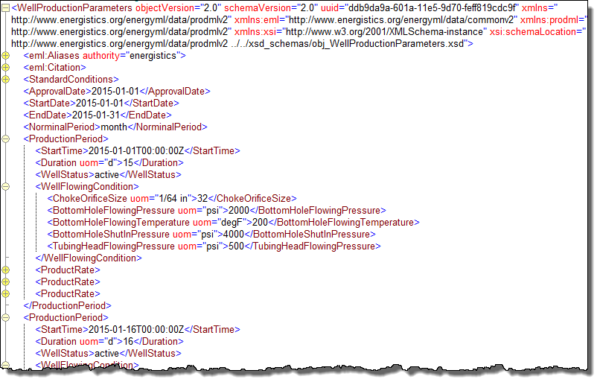
Well Production Parameters can transfer a range of well parameters across any number of discrete periods
Example, if Well Status or Choke Orifice Size changes during the period being reported for Volumes, the Period can be sub-divided into Production Periods each with own Parameters
Well Status and a range of operating parameters can be reported
Product Rates can also be transferred
This is the example for Well 1 and the choke changes correspond to the period being split into two sub-periods, see Slide 27

